Slide 1
Signal Attenuation & Distortion in Optical Fibers
What are the loss or signal attenuation mechanism in a fiber?
Why & to what degree do optical signals get distorted as they propagate down a fiber?
Signal attenuation (fiber loss) largely determines the maximum repeaterless separation between optical transmitter & receiver.
Signal distortion cause that optical pulses to broaden as they travel along a fiber, the overlap between neighboring pulses, creating errors in the receiver output, resulting in the limitation of information-carrying capacity of a fiber.

Slide 2
Attenuation (fiber loss)
Power loss along a fiber:
The parameter is called fiber attenuation coefficient in a units of for example [1/km] or [nepers/km]. A more common unit is [dB/km] that is defined by:
Z=0
P(0) mW
Z= l
mw

Slide 3
Attenuation
Scattering Losses
Radiative losses/ Bending losses
Absorption
Intrinsic Absorption
Extrinsic (Impurity atoms)
Atomic Defects
Microscopic bends
Macroscopic bends
Absorption in
Infrared region
Absorption in Ultraviolet region
Inhomogeneities or defects
in fiber
Compositional fluctuations in material

Slide 4
Absorption
Absorption is caused by three different mechanisms:
1. Impurities in fiber material: from transition metal ions (must be in order of ppb) & particularly from OH ions with absorption peaks at wavelengths 2700 nm, 400 nm, 950 nm & 725nm.
2. Intrinsic absorption (fundamental lower limit): electronic absorption band (UV region) & atomic bond vibration band (IR region) in basic SiO2.
3. Radiation defects

Slide 5
Absorption
1. Absorption by atomic defects
Atomic defects are imperfections in the atomic structure of the fiber material.
Examples:
Missing of molecules
High density clusters of atom groups
Oxygen defects in the glass structure.
Absorption losses arising from these defects are negligible
compared with intrinsic and impurity absorption.
Can be significant if the fiber is exposed to ionization radiations.

Slide 6
2. Extrinsic absorption by impurity atoms
The dominant absorption factor in silica fibers is the presence of minute quantities of impurities in the fiber material.
These impurities include
OH- (water) ions dissolved in the glass.
Transition metal ions, such as iron, copper, chromium and vanadium
Origin :
OH ion impurities in a fiber preform results mainly from the oxyhydrogen flame used in the hydrolysis reaction of the SiCl₄, GeCl₄ and POCl₃ starting materials.

Slide 7
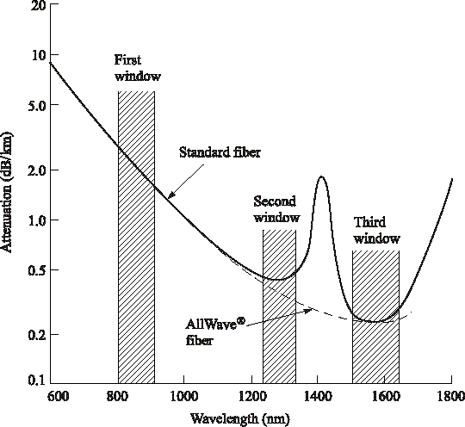
Optical Fiber communications, 5th ed.,G.Keiser,McGrawHill
Optical fiber attenuation as a function of wavelength yields nominal values of 0.5 dB/km at 1310 nm and 0.3 dB/km at 1550 nm for standard single mode fiber. Absorption by the water molecules causes the attenuation peak around 1400nm for standard fiber. The
dashed curve is the attenuation for low water peak fiber.

Slide 8
3. Intrinsic absorption by the basic constituent atoms
Intrinsic absorption is associated with the basic fiber material (e.g pure SiO₂).
Intrinsic absorption results from:
Electronic absorption bands in the ultraviolet region
Atomic vibration bands in the near infrared region

Slide 9
Electronic absorption (EA) occurs when a photon interacts with an electron in the valance band and excites it to a higher energy level. The electronic absorption is associated with the band gap of the material
empirical formula
_{= Ce}E / E_{o}
α
uv
Ultraviolet
absorption
decays
exponentially
with with
increasing wavelength and is small compared
scattering loss in the near infrared region. UV loss in dB/km at any as a function of mole fraction x of GeO₂ is
154.2x
⎛
4.63
λ
⎞
α = ×10 exp
−2
⎜
⎟
uv
46.6x + 60
⎝ ⎠

Slide 10
2. The inherent infrared absorption is associated with the vibration frequency of chemical bond between the atoms of which the fiber is composed.
An interaction between the vibrating bond and the electromagnetic field of the optical signal results in a transfer of energy from the field to the bond and thereby giving rise to absorption.
This absorption is quite strong because of many bonds present in the fiber. Example: GeO₂-SiO₂.
⎛
− 48.48
λ
⎞
α = 7.81×10 ×exp
11
⎜
⎟
IR
⎝
⎠

Slide 11
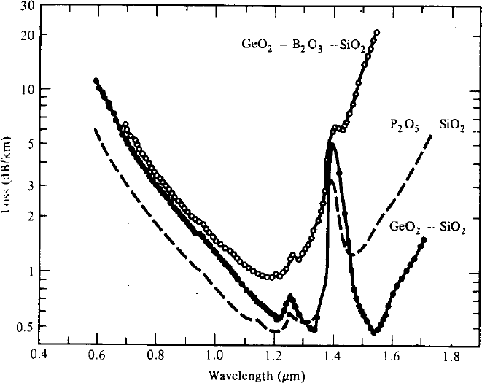
Optical Fiber communications, 5th ed.,G.Keiser,McGrawHill
A comparison of the infrared absorption induced by various doping materials in low-loss silica fibers.

Slide 12
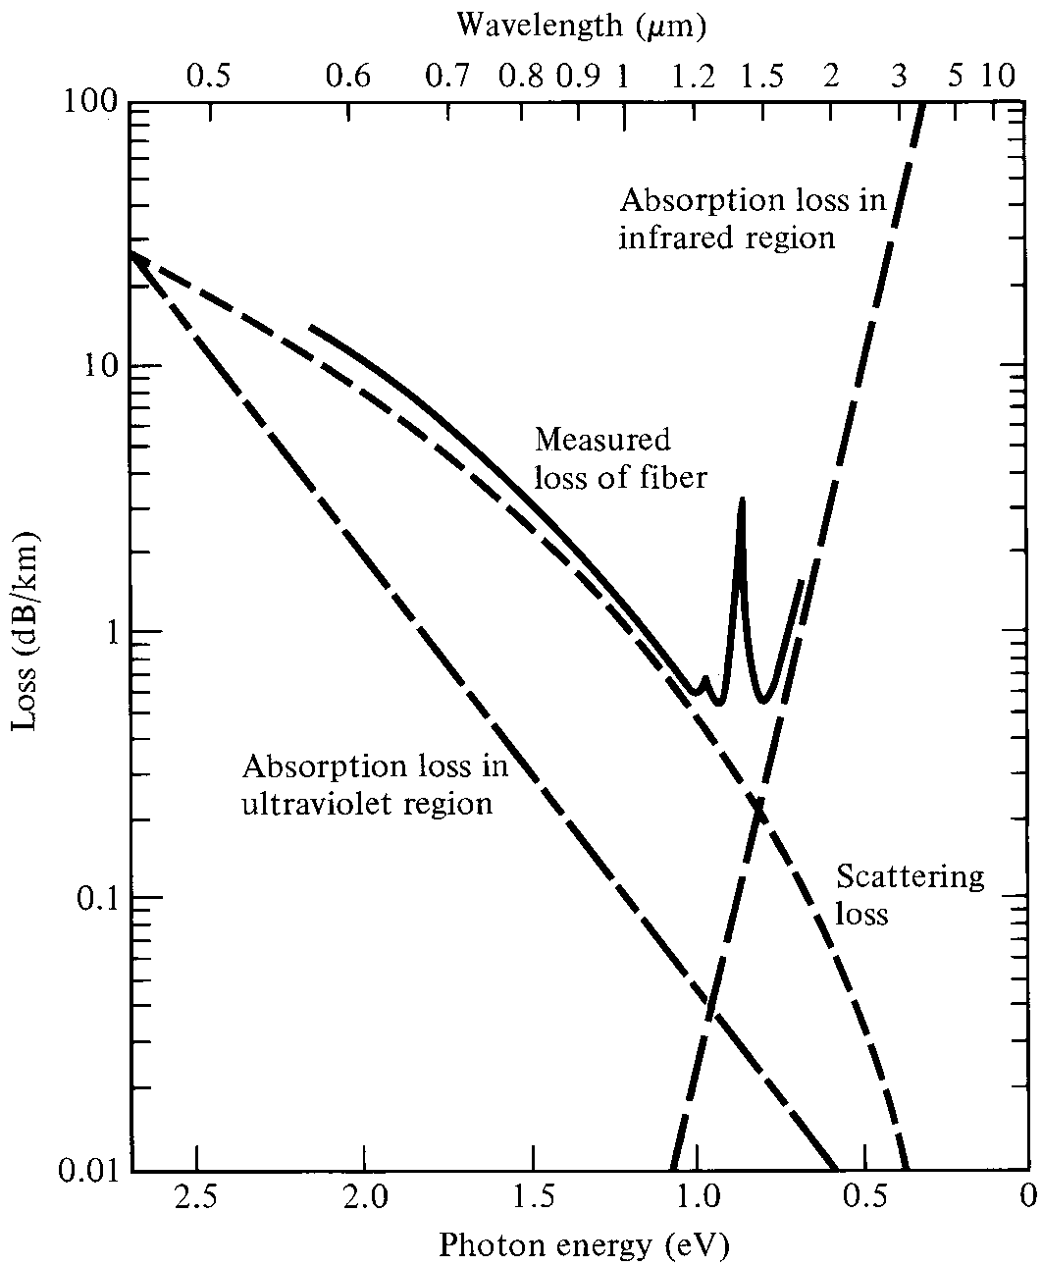
Absorption & scattering losses in fibers
Optical Fiber communications, 5th ed.,G.Keiser,McGrawHill,

Slide 13
Scattering Loss
Small (compared to wavelength) variation in material density, chemical composition, and structural inhomogeneity scatter light in other directions and absorb energy from guided optical wave.
The essential mechanism is the Rayleigh scattering. Since the black body radiation classically is proportional to (this is true for wavelength typically greater than 5 micrometer), the attenuation coefficient due to Rayleigh scattering is approximately proportional to . This seems to me not precise, where the attenuation of fibers at 1.3 & 1.55 micrometer can be exactly predicted with Planck’s formula & can not be described with Rayleigh-Jeans law. Therefore I believe that the more accurate formula for scattering loss is

Slide 14
Scattering Losses
Scattering losses in glass arise from microscopic variation
in the material density from:
Compositional fluctuations
Inhomogeneities or defects occurring during fiber manufacture
These two effects give rise to refractive index variation, occurring within the glass over distances that are small compared with the wavelength.
These index variation case Rayleigh-type scattering of the light and inversely proportional to wavelength.
It decreases dramatically with increasing wavelength

Slide 15
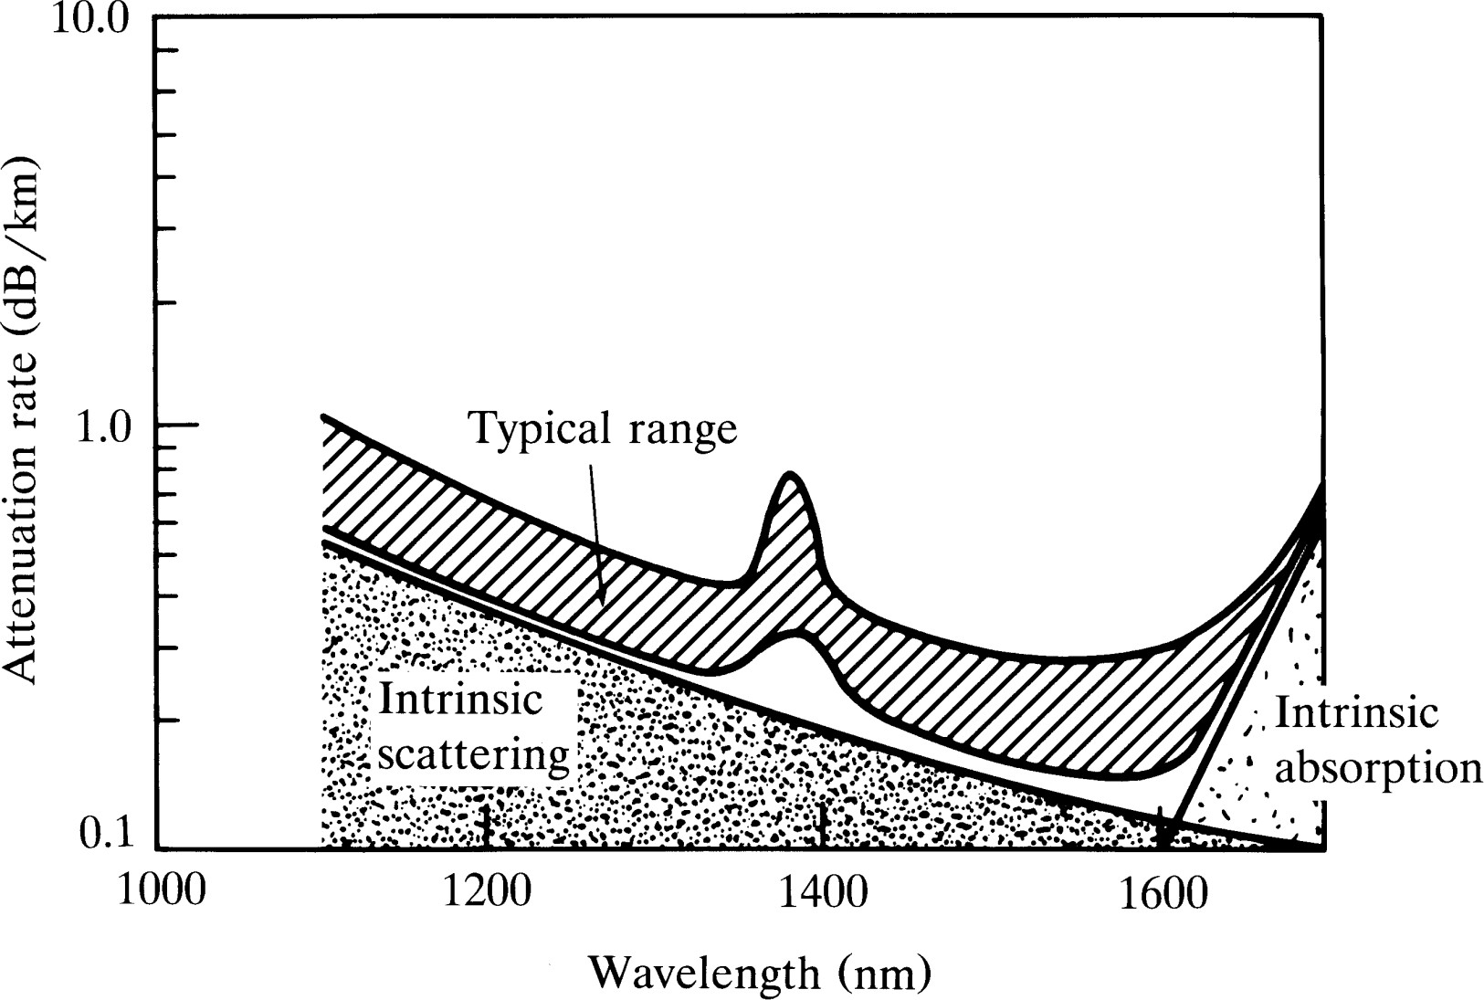
Optical Fiber communications, 5th ed.,G.Keiser,McGrawHill
Combining the infrared, ultraviolet, and scattering losses for
single mode fiber.

Slide 16
Radiative losses / Bending Losses
Radiative losses occur whenever an optical fiber undergoes a bend of finite radius of curvature.
Fiber can be subject to two types of bends:
Macroscopic bends
Microscopic bends
Macrobending: Light lost from the optical core due to macroscopic effects such as tight bends being induced in the fiber itself.
Microbending. Light lost from the optical core due to microscopic effects resulting from deformation and damage to the core cladding interface.

Slide 17
Radiative losses / Bending Losses
For the slight bends losses are unobservable
By decreasing radius of curvature we will come to the critical value after which these losses increase drastically.
As we know that the electric/magnetic field have a tail in the cladding region so by bending the cable we come to the extent where cladding field should move faster to keep up with the core field.
As this is not possible so the energy in that region radiates away
Radiation losses depend on the value of xc and radius of curvature R
As the lower order modes remain close to the core axis and the higher modes are closer to the cladding so the higher modes will radiate out of the fiber first.

Slide 18
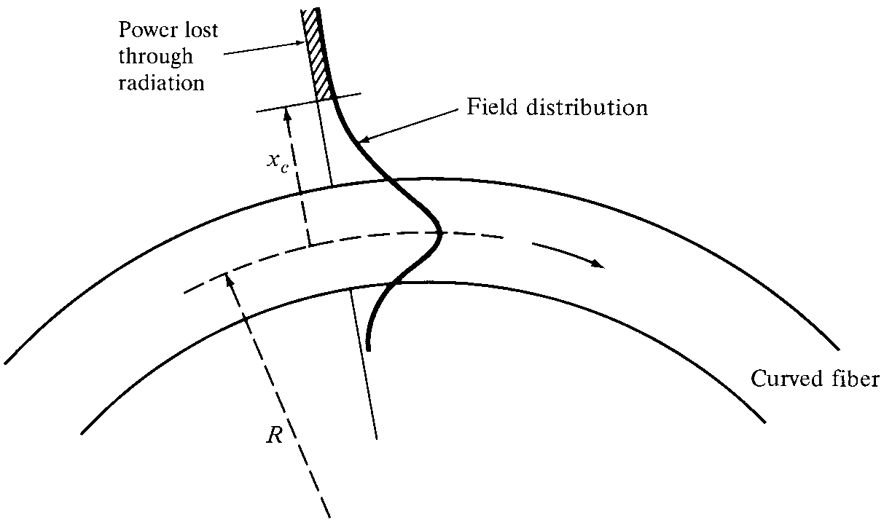
Radiative losses / Bending Losses
Macrobending losses are normally produced by poor handling of fiber .
Poor reeling and mishandling during installation can create severe bending of the fiber resulting in small but important localized losses
Optical Fiber communications, 5th ed.,G.Keiser,McGrawHill

Slide 19

Bending Loss (Macrobending & Microbending)
Macrobending Loss: The curvature of the bend is much larger than fiber diameter. Lightwave suffers sever loss due to radiation of the evanescent field in the cladding region. As the radius of the curvature decreases, the loss increases exponentially until it reaches at a certain critical radius. For any radius a bit smaller than this point, the losses suddenly becomes extremely large. Higher order modes radiate away faster than lower order modes.
Optical Fiber communications, 5th ed.,G.Keiser,McGrawHill

Slide 20
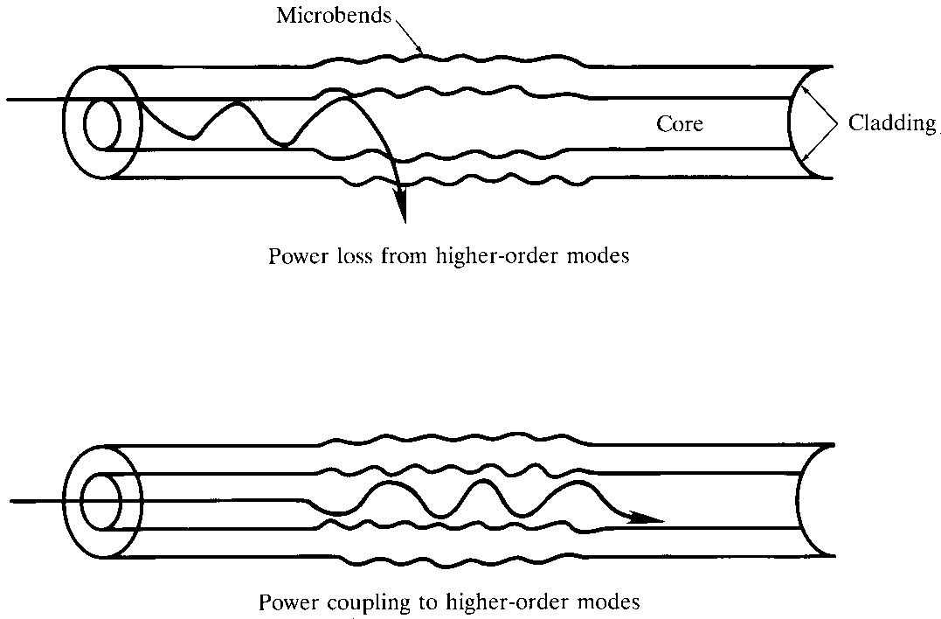
Microbending Loss
Microbending Loss: microscopic bends of the fiber axis that can arise when the fibers are incorporated into cables. The power is dissipated through the microbended fiber, because of the repetitive coupling of energy between guided modes & the leaky or radiation modes in the fiber.
Optical Fiber communications, 5th .edition G.Keiser,McGrawHill

Slide 21
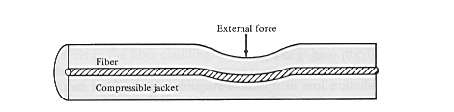
Minimizing microbending losses:
Optical Fiber communications, 5th ed.,G.Keiser,McGrawHill
A compressible jacket extruded over a fiber reduces microbending resulting from external forces.

Slide 22
Dispersion in Optical Fibers
Dispersion: Any phenomenon in which the velocity of propagation of any electromagnetic wave is wavelength dependent.
In communication, dispersion is used to describe any process by which any electromagnetic signal propagating in a physical medium is degraded because the various wave characteristics (i.e., frequencies) of the signal have different propagation velocities within the physical medium.
There are 3 dispersion types in the optical fibers, in general:
1- Material Dispersion
2- Waveguide Dispersion
3- Polarization-Mode Dispersion
Material & waveguide dispersions are main causes of Intramodal Dispersion.

Slide 23
Signal Distortion/ Dispersion
Intramodal Dispersion/
Chromatic Dispersion
Intermodal Delay/
Modal Delay
Polarization-mode
Dispersion
Material Dispersion
Waveguide Dispersion

Slide 24
Dispersion
The basic need is to match the output waveform to the input waveform as closely as possible.
Attenuation only reduces the amplitude of the output waveform which does not alter the shape of the signal.
Dispersion distorts both pulse and analog modulation signals.

Slide 25
Dispersion
Dispersion results when some components of the input signal spend more time traversing the fiber than other components.
In a pulse modulated system, this causes the received pulse to be spread out over a longer period.
It is noted that actually no power is lost to dispersion, the spreading effect reduces the peak power.

Slide 26
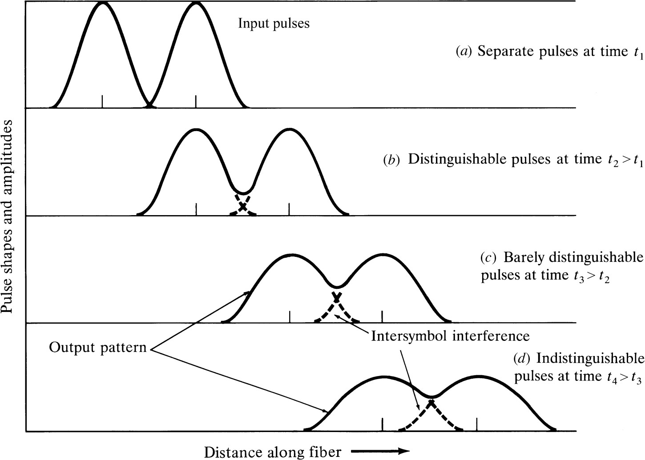
Optical Fiber communications, 5th ed.,G.Keiser,McGraw Hill
Pulse broadening and attenuation

Slide 27
Dispersion of optical energy within an optical fiber falls into following categories:
Intermodal Delay or Modal Delay
Intramodal Dispertion or Chromatic Dispersion
Material Dispertion
Waveguide Dispertion
Polarization –Mode Dispersion

Slide 28
Intermodal delay/ modal delay
Intermodal distortion or modal delay appears only in
multimode fibers.
This signal distortion mechanism is a result of each mode having a different value of the group velocity at a single frequency.
The amount of spreading that occurs in a fiber is a function of the number of modes propagated by the fiber and length of the fiber
Group Velocity: It is the speed at which energy in a particular mode travels along the fiber.

Slide 29
Intermodal delay/ modal delay
The maximum pulse broadening arising from the modal delay is the difference between the travel time T_{max} of the
longest ray and the travel time T_{min} of the shortest ray .
This broadening is simply obtained from ray tracing for a fiber of length L:
∆T= T_{max} – T_{min} = n1/c ( L/sinø_{c} –L) = (Ln₁²/cn₂)∆
∆T= T_{max} – T_{min} = (Ln₁²/cn₂)∆

Slide 30
Intermodal delay/ modal delay
Fiber Capacity:
Fiber capacity is specified in terms of the bit rate-distance
product BL.
(Bit rate times the possible transmission distance L)
For neighboring signal pulses to remain distinguishable at the receiver, the pulse spread should be less than 1/B.
Or
Pulse spread should be less than the width of a bit period.
∆T < 1 /B General requirement
∆T ≤ 0.1 /B For high performance link
Bit rate distance product BL < n₂ c/ n₁² ∆

Slide 31
How to get one mode and solve the problem
we could decrease the number of modes by increasing the wavelength of the light.
Changing from the 850 nm window to the 1550 nm window will only reduce the number of modes by a factor of 3 or 4.
Change in the numerical aperture can help but it only makes a marginal improvement.
We are left with the core diameter. The smaller the core,
the fewer the modes.
When the core is reduced sufficiently the number of modes can be reduced to just one.

Slide 32
Q: Consider a 1 Km long multimode fiber in which n₁= 1.480 and ∆ = 0.10 , so that n₂= 1.465.
Then find ∆T= ?
Where:
L = 1 Km n₁ = 1.480
n₂= 1.465
∆ = 0.10
∆T = (Ln₁²/cn₂)∆

Slide 33
How to characterize dispersion?
Group delay per unit length can be defined as:
If the spectral width of the optical source is not too wide, then the delay difference per unit wavelength along the propagation path is approximately For spectral components which are apart, symmetrical around center wavelength, the total delay difference over a distance L is:

Slide 34
is called GVD parameter, and shows how much a light pulse broadens as it travels along an optical fiber. The more common parameter is called Dispersion, and can be defined as the delay difference per unit length per unit wavelength as follows:
In the case of optical pulse, if the spectral width of the optical source is characterized by its rms value of the Gaussian pulse , the pulse spreading over the length of L, can be well approximated by:
D has a typical unit of [ps/(nm.km)].

Slide 35
Intramodal Dispersion or Chromatic Dispersion
This takes place within a single mode.
Intramodal dispersion depends on the wavelength, its effect on signal distortion increases with the spectral width of the light source.
Spectral width is approximately 4 to 9 percent of a central wavelength.
Two main causes of intramodal dispersion are as:
Material Dispersion
Waveguide Dispersion

Slide 36



Material Dispersion
Input
Cladding
v_{g}(λ₁ ) _{Core} v_{g}(λ₂ )
Emitter
Output
Very short light pulse
Intensity
Intensity
Intensity
Spectrum, ² λ
Spread, ² τ
λ
t
t
λ₁
λ_{o} λ₂
0
τ
All excitation sources are inherently non-monochromatic and emit within a spectrum, ² λ, of wavelengths. Waves in the guide with different free space wavelengths travel at different group velocities due to the wavelength dependence of n₁. The waves arrive at the end of the fiber at different times and hence result in
a broadened output pulse.
© 1999 S .O. Kasap, Optoelectronics (Prentice Hall)

Slide 37
Intramodal Dispersion or Chromatic Dispersion
Material Dispersion:
This refractive index property causes a wavelength dependence of the group velocity of a given mode; that is,
Pulse spreading occurs even when different wavelength follow the same path.
Material dispersion can be reduced:
Either by choosing sources with narrower spectral output widths or by operating at longer wavelengths.

Slide 38
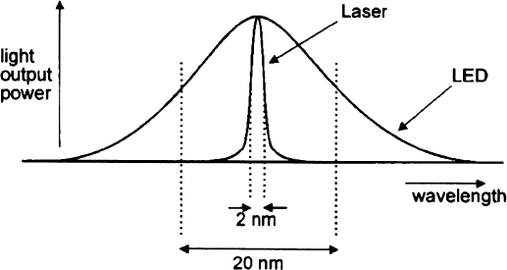
LASER source will produce far less spectral dispersion or intramodal
dispersion than an LED source since it is more nearly monochromatic

Slide 39
Material Dispersion
The refractive index of the material varies as a function of wavelength,
Material-induced dispersion for a plane wave propagation in homogeneous medium of refractive index n:
The pulse spread due to material dispersion is therefore:
is material dispersion

Slide 40
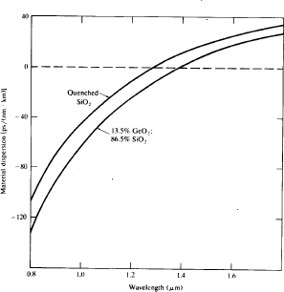
Optical Fiber communications, 5th ed.,G.Keiser,McGrawHill
Material dispersion as a function of optical wavelength for pure silica and
13.5 percent GeO₂/ 86.5 percent SiO₂.

Slide 41
Intramodal Dispersion or Chromatic Dispersion
Waveguide Dispersion:
It causes pulse spreading because only part of the optical power propagation along a fiber is confined to core.
Dispersion arises because the fraction of light power propagating in the cladding travels faster than the light confined to core.
Single mode fiber confines only 80 percent of the power in the core for V values around 2.
The amount of waveguide dispersion depends on the fiber design.

Slide 42
Waveguide Dispersion
Waveguide dispersion is due to the dependency of the group velocity of the fundamental mode as well as other modes on the V number, (see Fig 2-18 of the textbook). In order to calculate waveguide dispersion, we consider that n is not dependent on wavelength. Defining the normalized propagation constant b as:
solving for propagation constant:
Using V number:

Slide 43
Waveguide Dispersion
Delay time due to waveguide dispersion can then be expressed as:
Optical Fiber communications, 3rd ed.,G.Keiser,McGrawHill, 2000

Slide 44
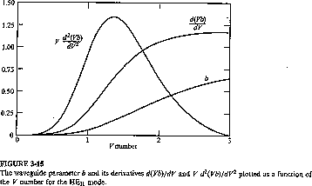
Signal Distortion in single mode fibers
For single mode fibers, waveguide dispersion is in the same order of material dispersion. The pulse spread can be well approximated as:
dτ _{wg}
dλ
n LΔσ
d ² (Vb)
^{ο} wg
≈
ο_{λ} = Lσ_{λ} D_{wg} (λ) = ^{2 λ} V
[3-25]
cλ
dV ²
D_{wg} (λ)
Optical Fiber communications, 3rd ed.,G.Keiser,McGrawHill, 2000

Slide 45
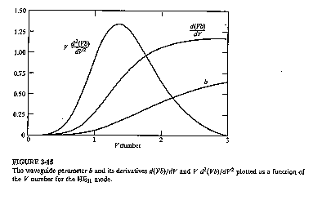
Signal Distortion in single mode fibers
For single mode fibers, waveguide dispersion is in the same order of material dispersion. The pulse spread can be well approximated as:
[3-25]
Optical Fiber communications, 3rd ed.,G.Keiser,McGrawHill, 2000

Slide 46
Signal Distortion in single mode fibers
For single mode fibers, waveguide dispersion is in the same order of material dispersion. The pulse spread can be well approximated as:
Optical Fiber communications, 3rd ed.,G.Keiser,McGrawHill, 2000

Slide 47

Polarization Mode dispersion Intensity
t
Output light pulse
z Δτ
n_{1 y} // y
Core
E_{x}
Δτ = Pulse spread
E_{x}
E
y
n_{1 x} // x
E_{y}
t
E
Input light pulse
Suppose that the core refractive index has different values along two orthogonal directions corresponding to electric field oscillation direction (polarizations). We can take x and y axes along these directions. An input light will travel along the fiber with E_{x}and E_{y} polarizations having different group velocities and hence arrive at the output at different times
© 1999 S.O. Kasap, Optoelectronics (Prentice Hall)

Slide 48
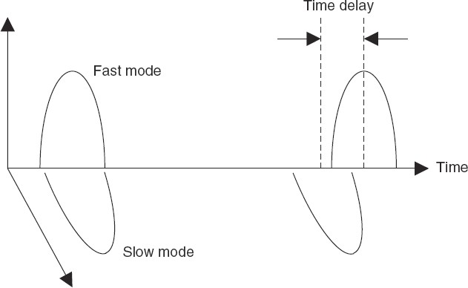
Optical Fiber communications, 5th ed.,G.Keiser,McGrawHill
Variation in the polarization states of an optical pulse as it passes through a fiber that has varying birefringence along its length.

Slide 49
Polarization Mode dispersion
The effects of fiber-birefringence on the polarization states of an optical are another source of pulse broadening. Polarization mode dispersion (PMD) is due to slightly different velocity for each polarization mode because of the lack of perfectly symmetric & anisotropicity of the fiber. If the group velocities of two orthogonal polarization modes are v_{gx} and v_{gy} then the differential time delay Δτ _{pol}between these two polarization over a distance L is
L ₋ L
Δτ =
pol
v v
gx gy
The rms value of the differential group delay can be approximated as:
^{Δτ} pol
^{≈ D}PMD
L

Slide 50
Chromatic & Total Dispersion
Chromatic dispersion includes the material & waveguide dispersions.
D_{ch} (λ) ≈ D_{mat} + D_{wg}
ο _{ch} = D_{ch} (λ)Lσ_{λ}
Total dispersion is the sum of chromatic , polarization dispersion and other dispersion types and the total rms pulse spreading can be approximately written as:
^{D}total ^{≈ D}ch ^{+ D}pol ^{+...}
^{σ} total ^{= D}total ^{Lσ}λ

